Slide 1
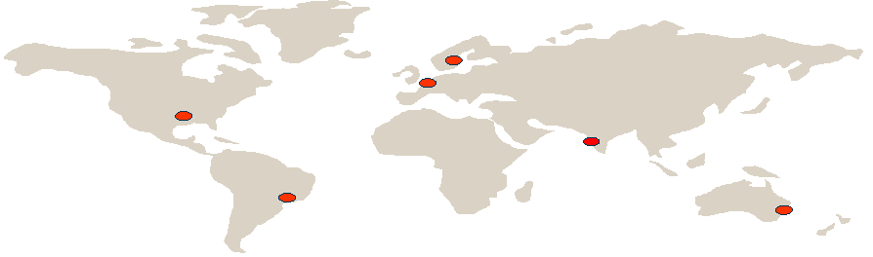
Using eTOM for
Efficient Operations
A Case Study
Stefan Åberg, Strategic Solution Architect, Ericsson
Contact: stefan.aberg@ericsson.com
Notes:
Using eTOM for Efficient Operations- A Case Study
2006-07-03

Slide 2
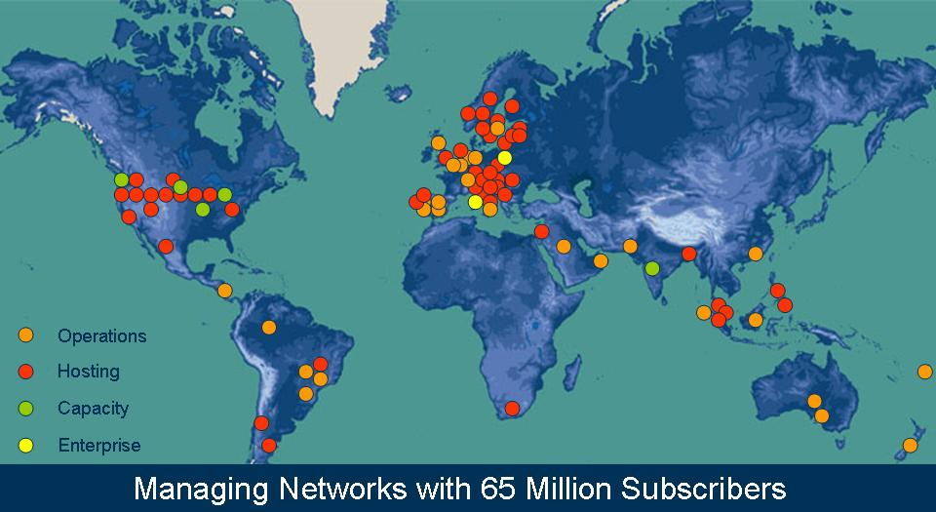
More than 100 announced Managed Services contracts since 2002 (examples)
Notes:
Using eTOM for Efficient Operations- A Case Study
2006-07-03

Slide 3
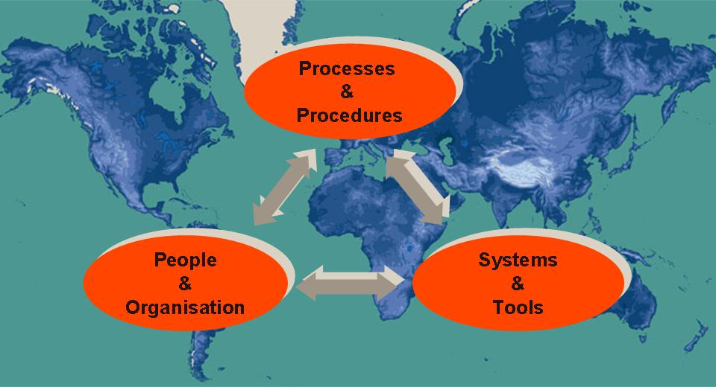
Implementing efficient solutions for global operations
Notes:
Using eTOM for Efficient Operations- A Case Study
2006-07-03

Slide 4
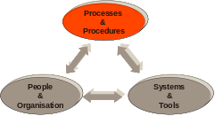
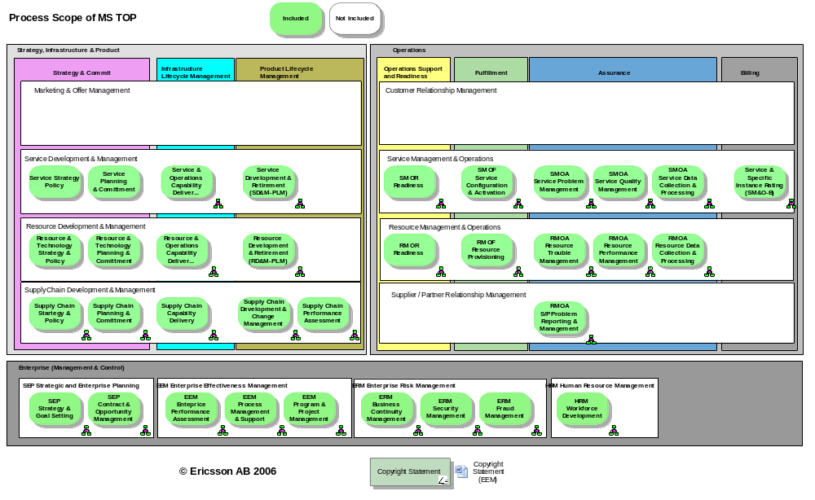
eTOM for global operation ➔ MS TOP
Notes:
Using eTOM for Efficient Operations- A Case Study
2006-07-03

Slide 5
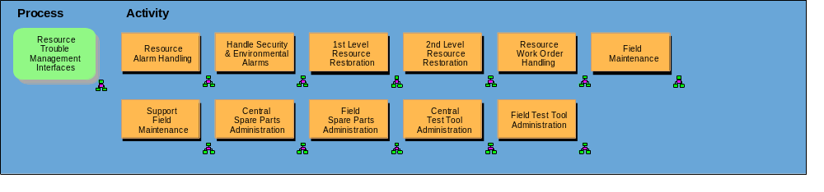
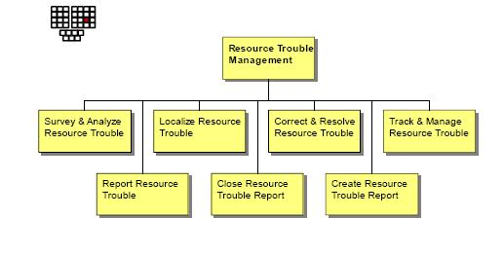
Enhanced Level 3
Resource Trouble Management
Source: MS-TOP
Source: eTOM 6.1
Notes:
Using eTOM for Efficient Operations- A Case Study
2006-07-03

Slide 6
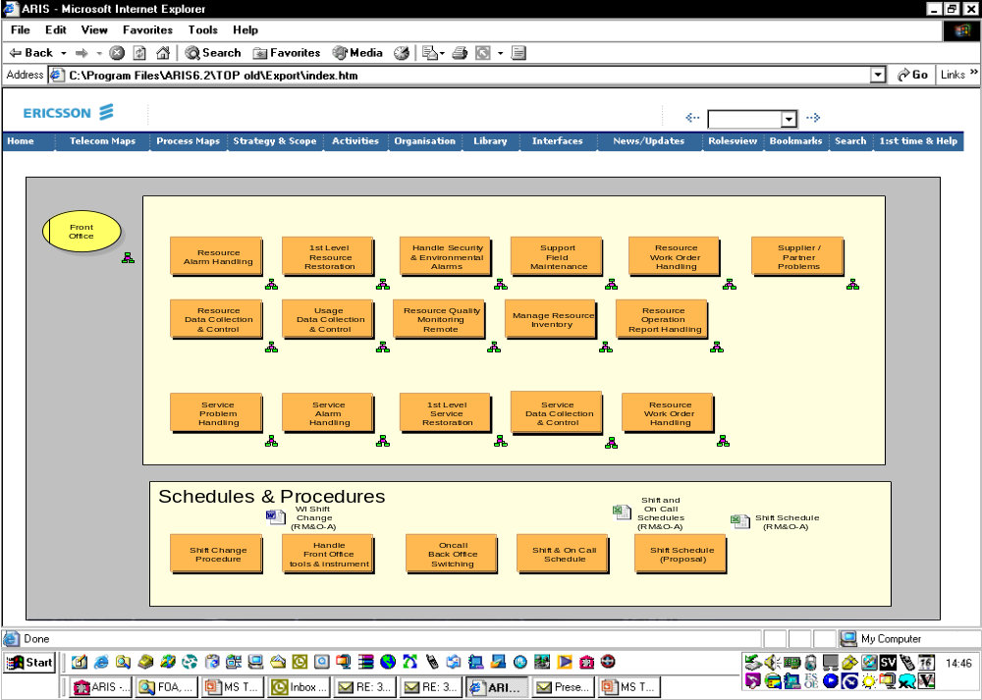
Notes:
Using eTOM for Efficient Operations- A Case Study
2006-07-03

Slide 7
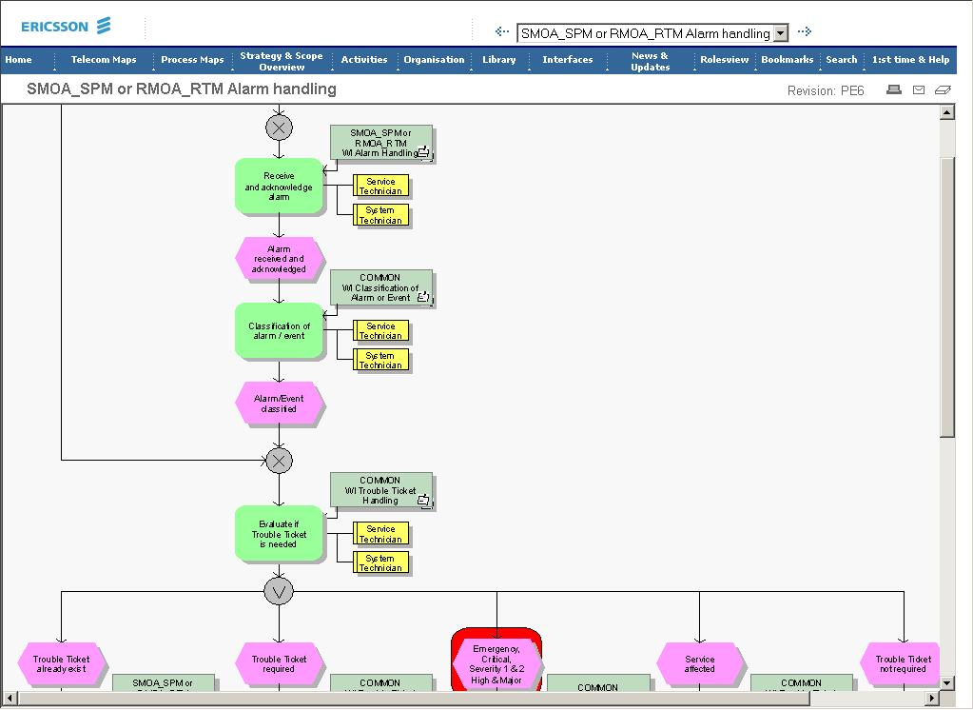
Notes:
Using eTOM for Efficient Operations- A Case Study
2006-07-03

Slide 8
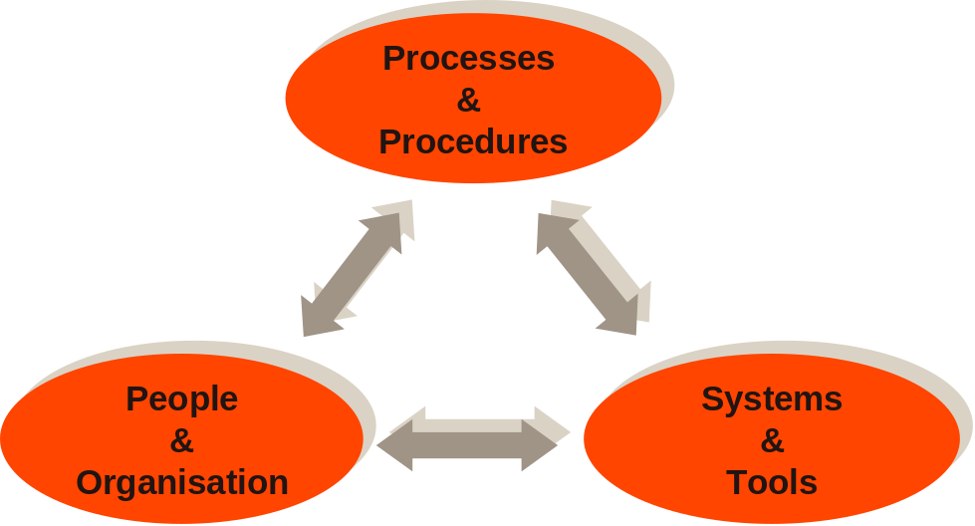
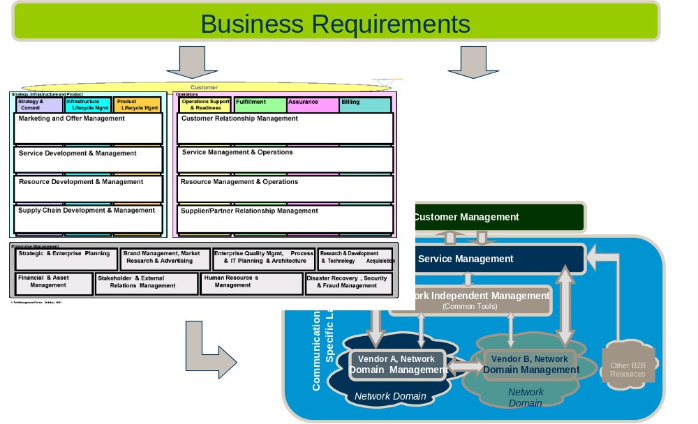
Key areas addressed
Make personnel using the processes
Align tools with the processes
Clearly define the organizational interfaces
Manage the lifecycle of the solution
Train
Maintain, Upgrade & Improve
Implement
Customize
Assess
Notes:
Using eTOM for Efficient Operations- A Case Study
2006-07-03

Slide 9
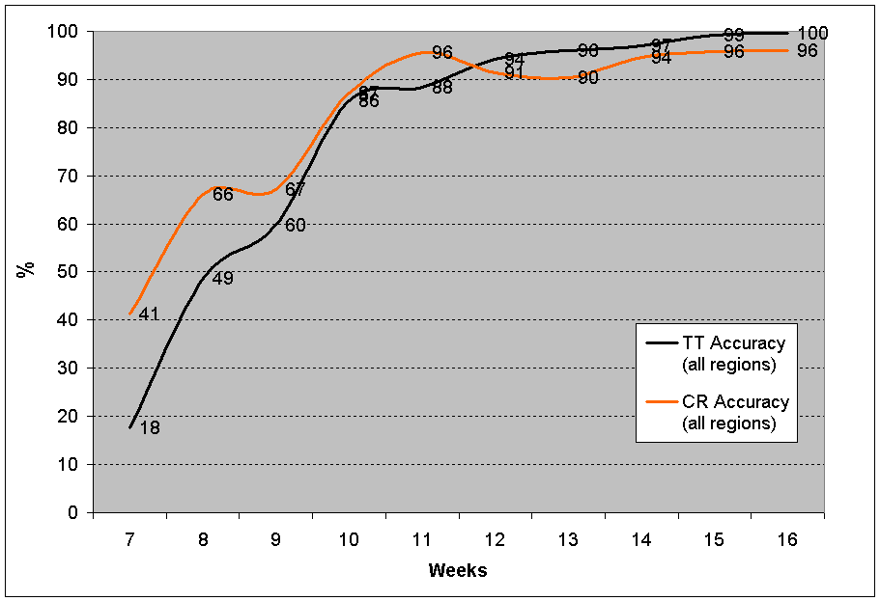
Values for global operation
Handover of between shifts and organizations
  More TT solved in FO
  Accurate information to field technicians
Reduced cost of adding new customer into operation
  Only add customer unique work instructions
Personnel can work with any customer
  Experts on few sites
  Business continuity
Notes:
Using eTOM for Efficient Operations- A Case Study
2006-07-03

Slide 10
Achieve efficient operation
Efficient operation is more the processes, do not forget…
Enhancements of eTOM is needed to enable efficient global operation
Prioritize changing management of personnel’s way of working

Slide 11





